Slide 1
BRANDING

Slide 2
1
What is a brand?
What is a personal brand?
Why is this important?

Slide 3
Which would you prefer?
vs.

Slide 4
It’s
SIMPLE
People invest in businesses that they trust

Slide 5
Your Personal Brand
Set Yourself Up for Success
Act in the way you wish to be perceived. Maximize your own potential.
Be Yourself.
Your personal brand is who you are. Find what makes you different.

Slide 6
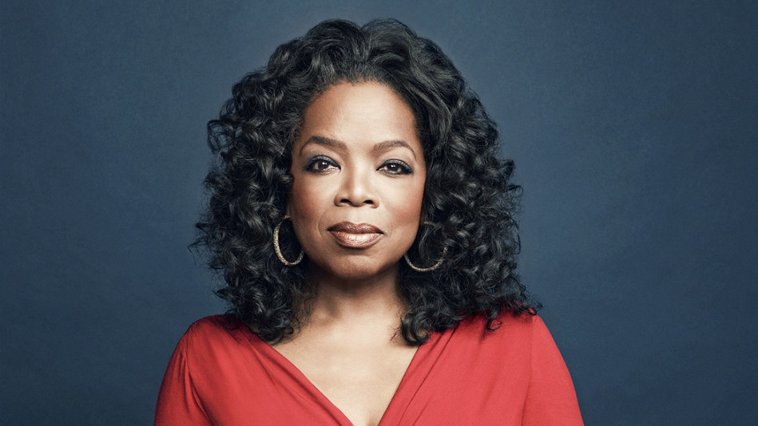
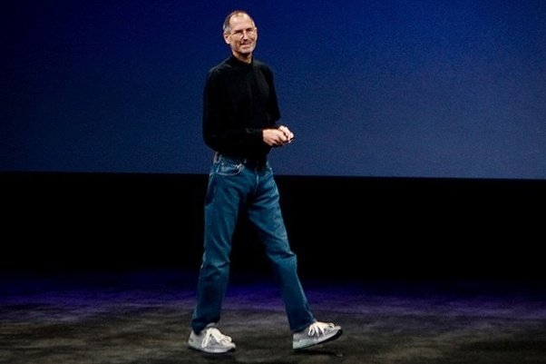
Examples of Personal Brand

Slide 7
How to Find Your Brand
How does your uniqueness translate to value?
What are your most significant accomplishments?
What do people come to you for?
What makes you special?
What are your greatest strengths?
What differentiates you from others?
What do you want to be known for?
What do you want others to think when they hear your name?

Slide 8
Your brand is what other people say about you when you’re not in the room.
-Jeff Bezos, Amazon

Slide 9
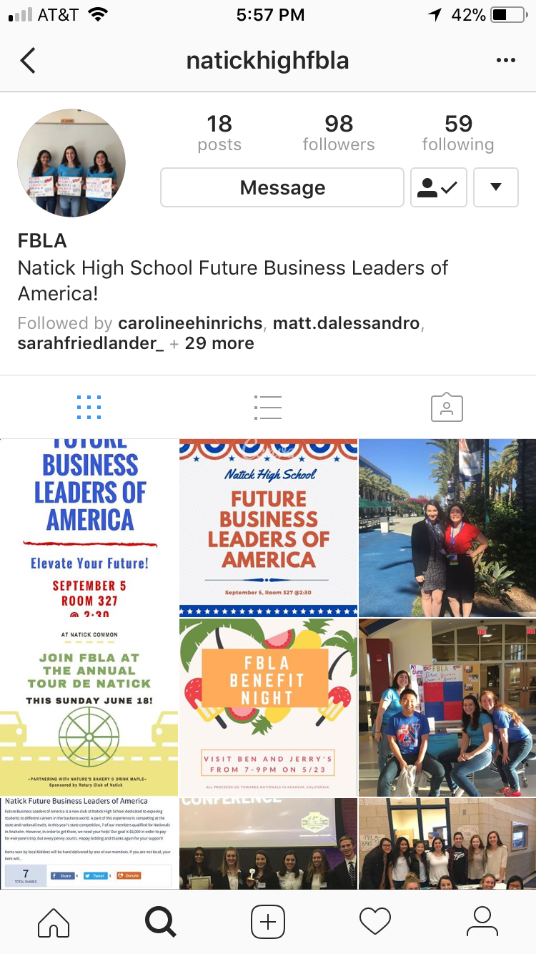
Building Your Brand
NETWORK!!!!
Get involved in your community
Present yourself and your brand well on social media
NLC success
Community outreach
Fundraising

Slide 10
At the end of the day, your network is your networth.

Slide 11
Why Does All This Matter?
Natick High School
Your personal brand is what you are presenting to the world
For anything, whether it be college or in the workplace

Slide 12
Remember:
Put your best foot forward
See yourself the way you want others to see yourself
Constantly be thinking of your brand and what makes you unique
Social media
Friends
Family

Slide 13
Questions?
Thank You!!!

Slide 14
Branding Game!
Get into small groups and think of your favorite brand names. What makes these brands successful? Unsuccessful? Would you make any changes to the brand?

