Slide 1
Entrepreneurship!

Slide 2
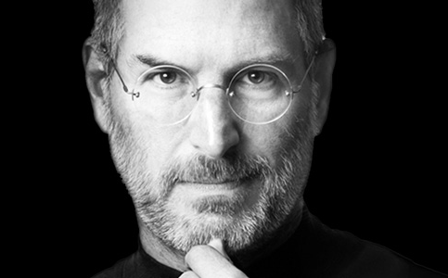
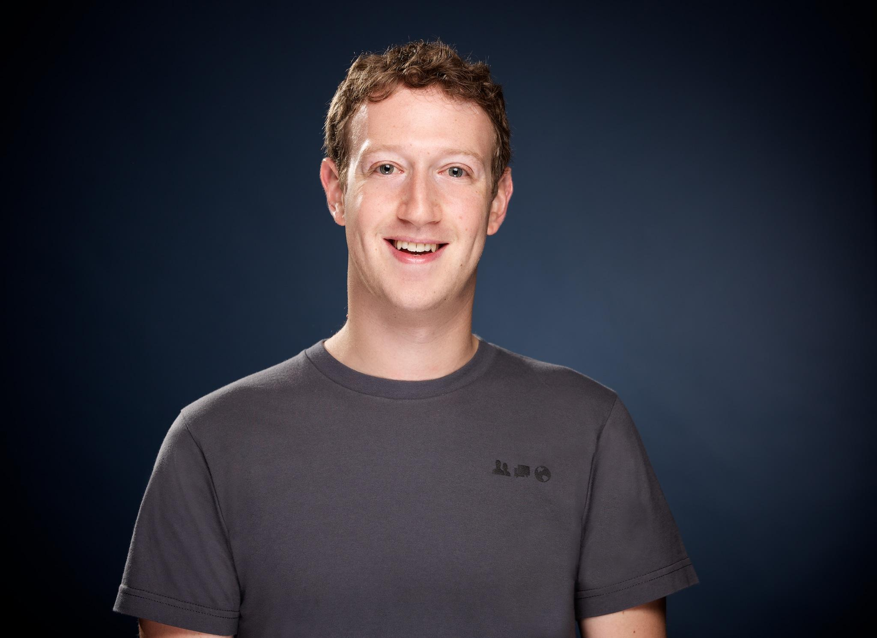
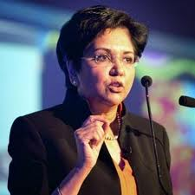
What do all these people have in common?
Steve Jobs
Mark Zuckerberg
Indra Nooyi
Notes:
Indra Nooyi- CEO of Pepsico which is the second largest food and drink company on the planet. She has not only excelled in business but also in academia, earning degrees in Physics, Chemistry and Mathematics as well as an MBA in management in her native India, she then went on to earn a Master’s degree in Public and Private Management at Yale.

Slide 3
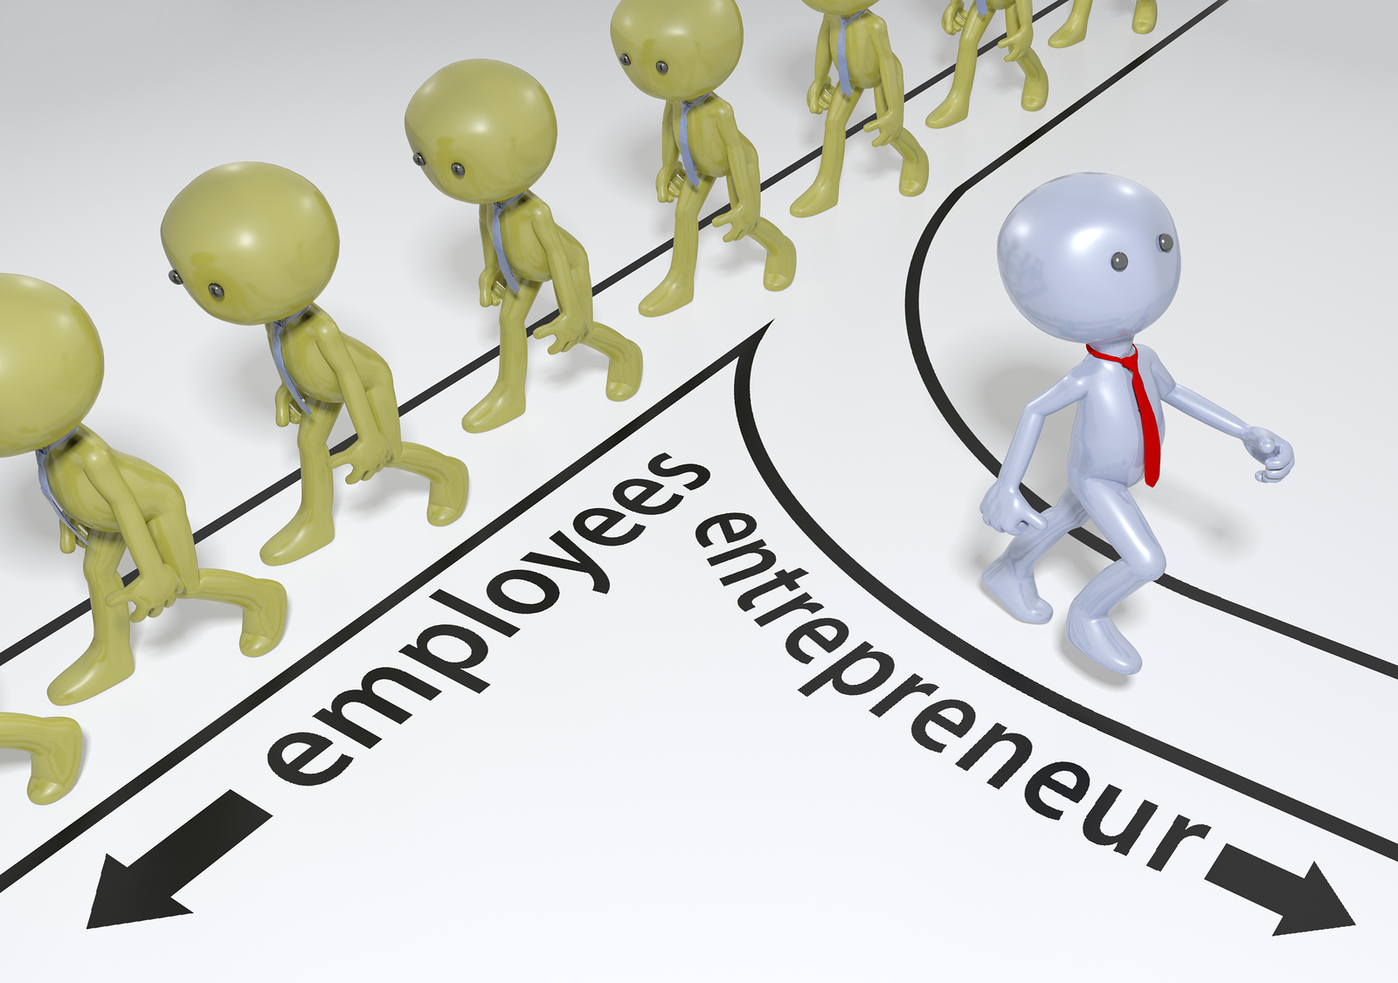
What is an entrepreneur? What do they do?
Someone one who organizes, manages, and assumes the risks of a business or enterprise
An entrepreneur has an innovative business idea and is willing to take the risk of implementing the idea
They take on the role as leader of the company or organization - assuming full responsibility for its execution, success, or failure

Slide 4
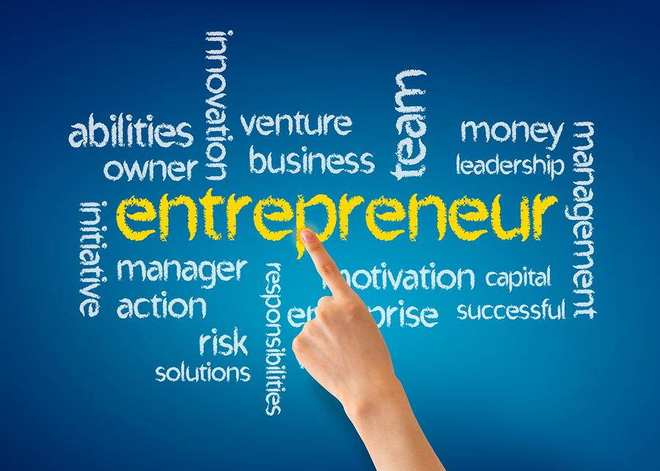
Notes:
Words associated with entrepreneurship

Slide 5
Entrepreneurship in the context of FBLA
Two to three person event
here

Slide 6
you try!

