Slide 1
the STOCK MARKET

Slide 2
What is the stock market?

Slide 3
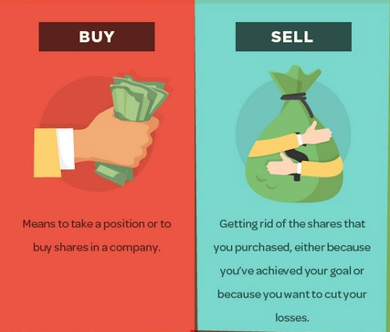
A Review:
A company divides itself into small pieces and sells those small pieces (IPO = Initial Public Offering)
Piece = stock
The buying and selling of a stock is what sets its price
Supply and Demand
People try to make a profit by predicting if a company’s stock will go up and purchasing it.
Why people compare it to gambling
Notes:
http://www.bbc.com/news/business-41972302

Slide 4
BUY LOW AND SELL HIGH
BUY LOW AND SELL HIGH

Slide 5
Trading Advice:

Slide 7
RULES:
Initial Amount $10,000
Contest closes at 4pm today
Primary Actions: Buying and Selling
Each has a brokerage fee of $10.00
Whoever gains the most amount of money wins the competition!
Pro tip: Don’t lose all your money.

Slide 8
BUY LOW AND SELL HIGH
BUY LOW AND SELL HIGH

